Slide 1
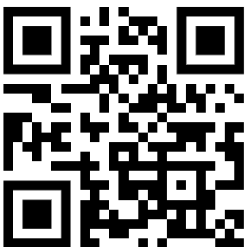
Die neue Perspektive Azure Management mit KI neu denken
Dr. Damir Dobric
Lead Software Architect daenet GmbH / ACP Digital
Microsoft Regional Director,
Most Valuable Professional: AI

Slide 2
AGENDA
Azure Management
MCP Approach
CLAW Approach
az cli
playwright

Slide 3
Azure Management
Azure Portal
ARM
PowerShell
Bicep
AZ CLI
Terraform

Slide 4
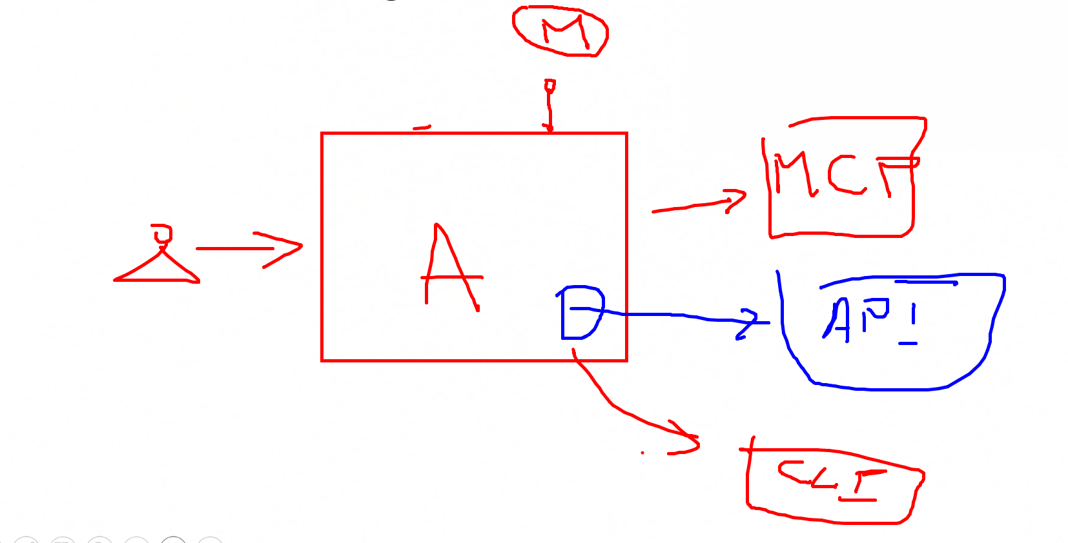
Management Neu Denken?
MCP Server Approach
Command Line Agent Workflow (CLAW) Approach

Slide 5
MCP Model Context Protocol

Slide 6
MCP
Created by Anthropic Adopted by the AI community

Slide 7
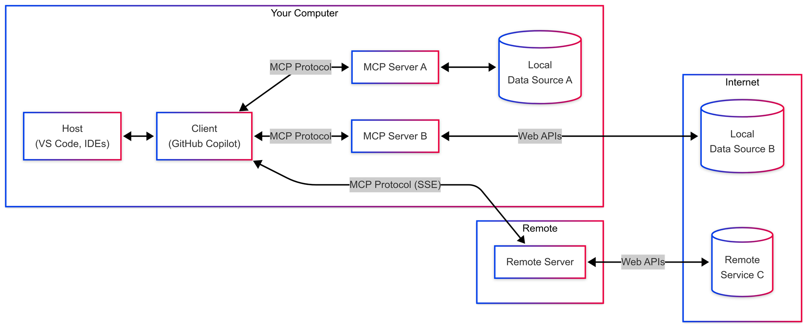
Why MCP and how does it work?
stdio
stdio
Application/Agent
http stream

Slide 8
Azure MCP Server
Application/Agent
stdio
Azure MCP Server
{
"mcpServers": {
"Azure MCP Server": {
"command": "npx",
"args": ["-y", "@azure/mcp@latest", "server", "start"]
}
}
}

Slide 9
DEMO Azure MCP Server
Claude Coworker
Console App

Slide 10
The CLAW Approach Command Line Agent Workflow

Slide 11
CLAW
AGENT
az account show
az cli
AGENT
powershell
intent
cmd
Show account info
any cli

Slide 12
DEMO CLAW
Console App CLAW Approach
AZ CLI
Playwright (wenn keine CLI vorhanden)

Slide 13
Die neue Perspektive DANKE ☺
Dr. Damir Dobric
Lead Software Architect daenet GmbH / ACP Digital
Microsoft Regional Director,
Most Valuable Professional: AI

Slide 14

User -> Model Chat iteraction
User: How are you?
(1)
AI
Prompt
(2)
Assistent: I‘m fine, how can I help you

Slide 15
Function Calling Specification
{
"type": "function",
"function": {
"name": "get_weather",
"description": "Retrieves current weather for the given location.",
"strict": true,
"parameters": {
"type": "object",
"properties": {
"location": {
"type": "string",
"description": "City and country e.g. Bogotá, Colombia"
},
"units": {
"type": ["string", "null"],
"enum": ["celsius", "fahrenheit"],
"description": "Units the temperature will be returned in."
}
},
"required": ["location", "units"],
"additionalProperties": false
}
}
}

Slide 16
Function Calling
User: Switch on the light to green.
LichtPlugin
SwitchLightOn(color)
SwitychLightOff
(1)
WeatherPlugin
ShowInfo(Location)
AI
Prompt
(2)
My Database
Tool: SwitchLightOn(green)

Slide 17
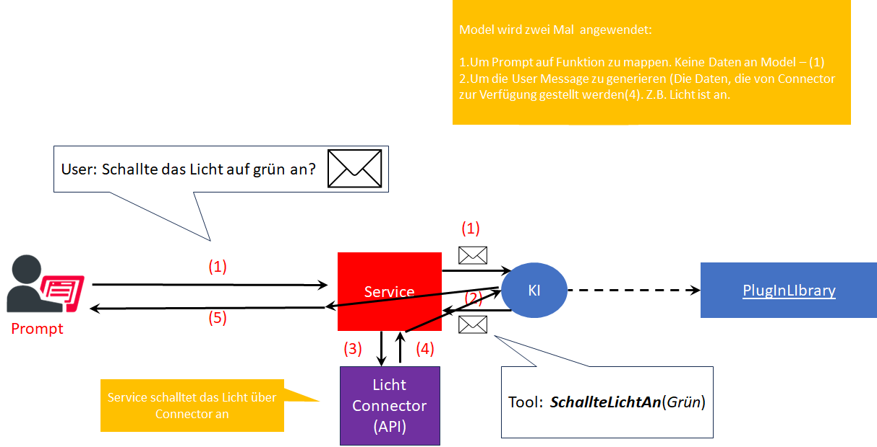
Function Calling

